Slide 1
The Eight Parts of Speech

Slide 2
What are the 8 Parts of Speech?
Noun
Pronoun
Adjective
Verb
Adverb
Conjunction
Preposition
Interjection
You can click on each part of speech for a definition and example. However, this is not required as you will come to each page as you progress through the PowerPoint.

Slide 3
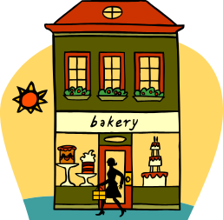

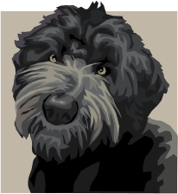
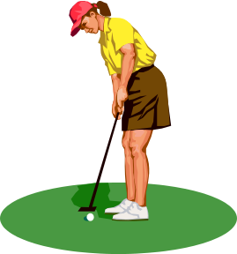
NOUNS
A noun is a person, place, thing, or idea.
Nouns are the subject of a sentence.
The bakery has fresh baked goods.
Kylie is a pro-golfer.
Go back to Eight Parts of Speech
Love is a beautiful thing.
The dog was lonely for me.
Move on

Slide 4
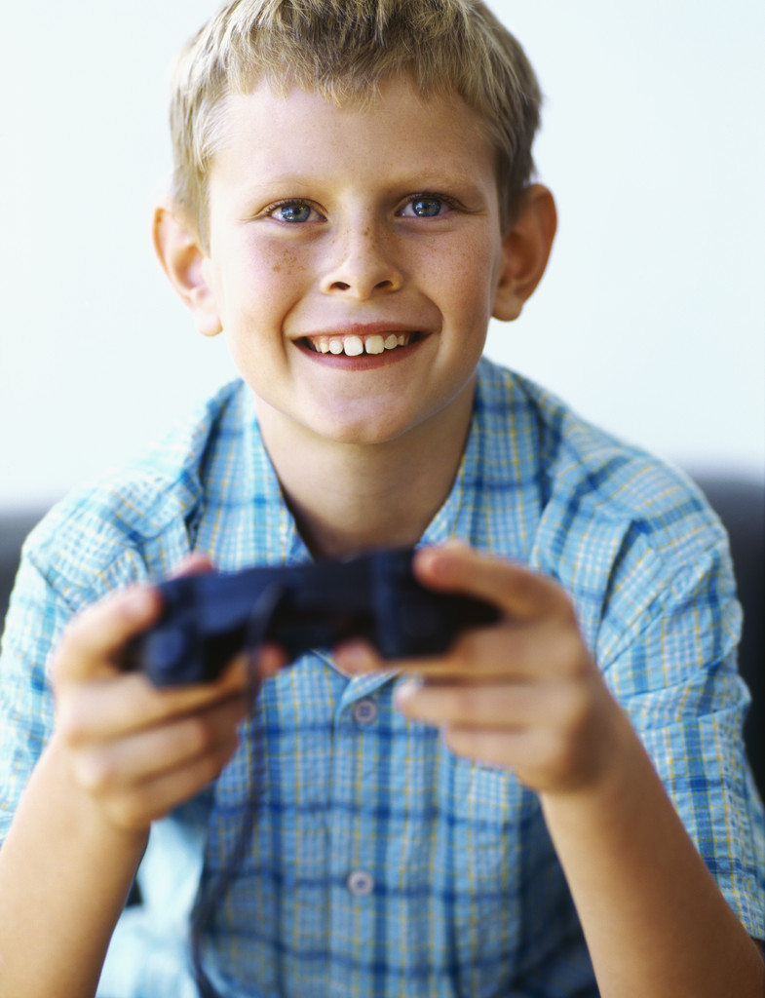
NOUNS
In the following sentence, which words are nouns?
Caleb loves to play Nintendo DS.
a. loves
b. play
c. Caleb and Nintendo DS

Slide 5
NOUNS
No, that is not correct. Remember a noun is a person, place, thing, or idea. Please try again!
Go back to Slide 5

Slide 6
NOUNS
Great job! Caleb and Nintendo are the nouns in this sentence. Caleb is a person and Nintendo DS is a thing.
Move on

Slide 7
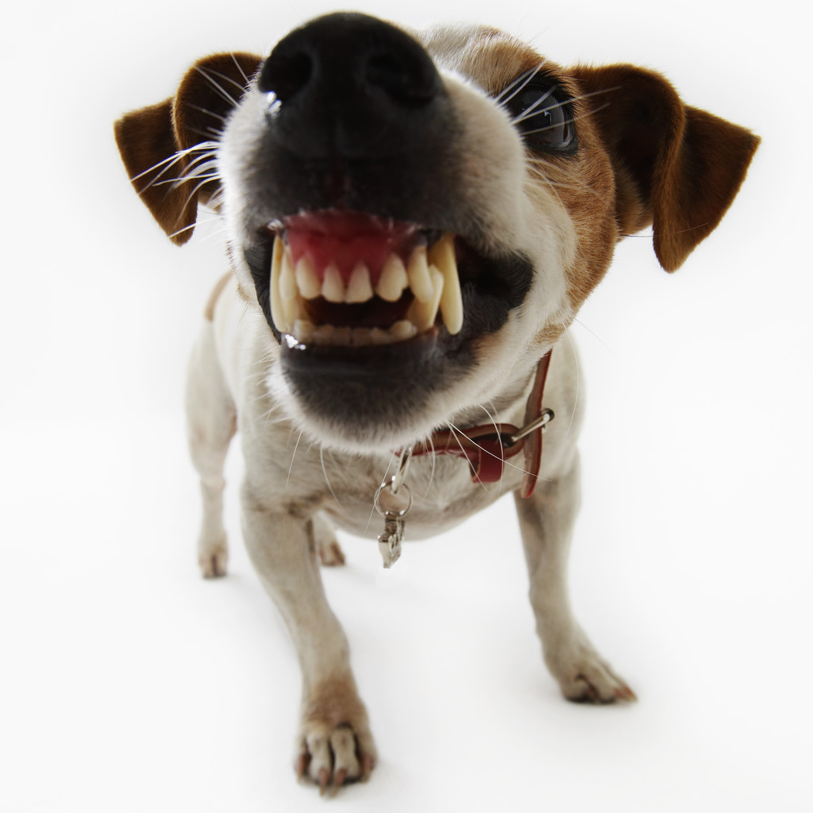

Types of Nouns
Common Noun- A noun that does not name a specific person, place or thing.
dog
Proper Noun- A noun that names a specific person, place or thing.
Move on
New York City

Slide 8
Common Nouns
The cow jumped over the moon.
We celebrated my birthday with a great, big, chocolate cake.
I ran the 5k race in town last week.
The cherries were very tasty.
I played basketball in gym class today.
Move on

Slide 9

Common Nouns
In the following sentence, what is the common noun?
Shaun cut the grass.
a. Shaun
b. cut
c. grass

Slide 10
Common Nouns
No, Shaun is a proper noun because it names a specific person. The word cut is verb because it tells what Shaun is doing. Try again- What is the common noun?
Go back to slide 10

Slide 11
Common Nouns
Yes! You are really getting the hang of this. Grass is the common noun in this sentence because it is a thing but is not specific.
Move on

Slide 12
Proper Nouns
West Middle School is a great place to learn!
Shopping at the Grand Traverse Mall can be hectic during the holidays.
I went to Horizon Cinemas to watch the movie Speed Racer.
Caleb and Kylie are the best kids in the world.
Read 180 has many good books to choose from.
Move on

Slide 13

Proper Nouns
Now let’s try proper nouns. Remember they name a specific person, place, or thing. What is the proper noun in this sentence?
He walked across the Mackinaw Bridge.
a. he
b. Mackinaw Bridge
c. walked

Slide 14
Proper Nouns
Oops! He is not the proper noun because “he” can be referring to anyone, not someone specific. Walked is the verb of the sentence. It tells what he is doing. Go back and try finding the proper noun. Look at the other examples if needed.
Go back to slide 14

Slide 15
Proper Nouns
Excellent! Mackinaw Bridge is the proper noun! It names a specific place.
Move on

Slide 16
Pronouns
A pronoun is a word that takes the place of a noun.
  Examples: I, me, my, you, your, he, she, it , us, we, they, them, his, her, their, mine, our, myself, himself, herself, itself, yourself, themselves, ourselves, who, whose, whom, anybody, anyone, everybody, nobody, someone, somebody.
Go back to Eight Parts of Speech
Move on

Slide 17

Pronouns
A pronoun is word that takes the place of a noun. Instead of saying “Erin likes to eat”, you could say, “She likes to eat.” What is the pronoun in the following sentence?
I sing loudly in the shower.
a. sing
b. loudly
c. I
d. shower

Slide 18
Pronouns
Good try but, sing cannot be the pronoun because it is the action. Loudly describes how I was singing. Shower is noun, a thing. See if you can find the pronoun. Go back and try again.
Go back to slide 18

Slide 19
Pronouns
Awesome! I is the pronoun because it takes the place of a noun. I replaces someone more specific like girl, boy, Bob, or Mrs. Ryan.
Move on

Slide 20
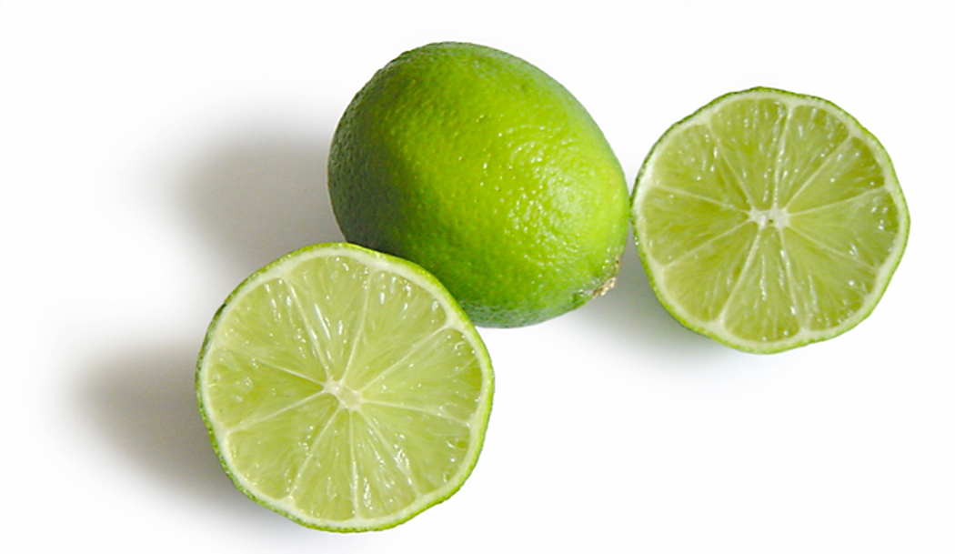

Adjective
An adjective is a word that describes a noun or pronoun. It tells what kind, how many, or which one.
sour limes
green shirt
Go back to Eight Parts of Speech
Move on

Slide 21
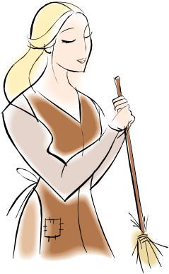
Adjective
Adjective- An adjective is a word that describes a noun or pronoun. It tells what kind, how many, or which one. Here is an example:
Erin has blonde hair.
Which word describes in this sentence. What
is the adjective?
a. blonde
b. Erin
c. hair

Slide 22
Adjective
No the answer is not Erin because that is the noun or subject of the sentence. Hair is also a noun. It does not describe anything. Good try- you can do this!
Go back to slide 22

Slide 23
Adjective
You are so smart! A. is the correct answer because blonde describe Erin’s hair! Great work.
Move on

Slide 24
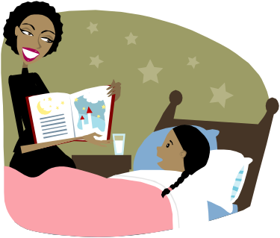
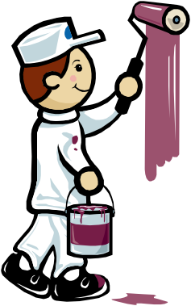
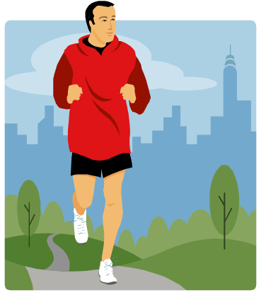
Verb
A verb is the action of the sentence. It shows what someone or something is doing.
Go back to Eight Parts of Speech
read
paint
Move on
run

Slide 25

Verb
Verb- A verb is the action of the sentences What is the subject doing? In the example below, find the verb.
Erin is running the 5K. What is Erin
doing?
a. Is
b. 5K
c. running

Slide 26
Verb
Oops! Your answer is not correct. “Is” is a helping verb. 5K is a type of race which means it is a noun.
Go back to slide 26

Slide 27
Verb
Yes! C. is the correct answer. Running is the verb. It tells what Erin is doing in the sentence.
Move on

Slide 28
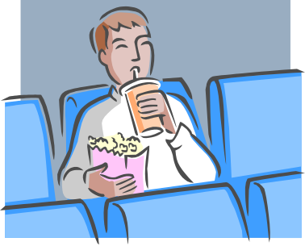

Adverb
An adverb describes how the action is performed. They tell how much, how often, when and where something is done.
The man sat alone.
The fished jumped quickly from the water.
Go back to Eight Parts of Speech
Move on

Slide 29

Adverb
Adverb- An adverb describes how the action is performed. They tell how much, how often, when and where something is done.
Erin ran the 5K quickly. How did she run the 5K?
a. Erin
b. ran
c. quickly

Slide 30
Adverb
Good try- Adverbs are challenging! Erin is the noun, the subject of the sentence. Ran is the verb. It tells what Erin is doing. What describes how Erin ran?
Go back to slide 30

Slide 31
Adverb
Fantastic! I am impressed! The adverb in the sentence is quickly. It tells how Erin ran the 5K race.
Move on

Slide 32
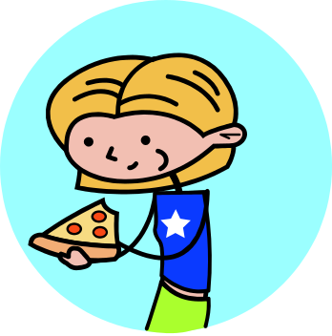

Conjunction
A conjunction is a word that joins words or word groups together. Some examples conjunctions are: and, but, or, nor, although, yet, so, either, and also.
Go back to Eight Parts of Speech
We ate pizza and drank pop for dinner.
Move on

Slide 33

Conjunction
Conjunction- A conjunction is a word that joins words or word groups together. Some examples conjunctions are: and, but, or, nor, although, yet, so, either, and also. Check out this example:
Erin loves to swim and play at the beach.
What is the conjunction in this sentence?
a. beach
b. swim, play
c. at
d. and

Slide 34
Conjunction
Sorry! Beach is a thing, a noun. Swim and play are verbs. They tell what Erin is doing. At is a preposition because it shows the position. Please go back and look for word that connects two ideas.
Go back to slide 34

Slide 35
Conjunction
Great! And is the conjunction in this sentence because it connects two word groups- Erin loves to swim AND play at the beach.
Move on

Slide 36


Preposition
A preposition is a word that shows position or, direction. Some examples are in, out, under, over, after, out, into, up, down, for, and between.
Go back to Eight Parts of Speech
She worked at her desk.
Move on
The sun was in the sky.

Slide 37


Preposition
Preposition- A preposition is a word that shows position or, direction. Some examples are in, out, under, over, after, out, into, up, down, for, and between. Try this.
I ran towards the school bus. Ask yourself first, “What
did I do?” I ran. Now ask, “Where- in which direction did
I run?” What is the preposition in this sentence?
a. towards
b. ran
c. school bus

Slide 38
Preposition
Did you ask yourself those questions? It is okay. Ran is the verb in the sentence (what I am doing) and school bus is a noun (a thing). Which direction did I run?
Go back to slide 38

Slide 39
Preposition
You are correct! Towards is the conjunction of this sentence because it tells the direction that I ran. Awesome work!
Move on

Slide 40
Interjection
Interjection- An interjection is a word that shows strong emotion. Such examples are Wow!, Ouch!, Hurray!, and Oh no!
Interjections can really liven up a sentence. They help to add voice to your writing.
Go back to Eight Parts of Speech
Superb!
Wow!
Ouch!
Move on

Slide 41

Interjection
Interjection- An interjection is a word that shows strong emotion. Such examples are Wow!, Ouch!, Hurray!, and Oh no!
Interjections can really liven up a sentence. They help to add voice to your writing. Check this out. Whew! I am so glad to have passed my exam. The word “Whew!” shows that I am relieved about passing my exam. Now you try it.
Wow! You did a fabulous job.
What is the interjection in this sentence?
a. job
b. fabulous
c. Wow!

Slide 42
Interjection
Oops! The word job is a noun (a thing). It really does not show emotion. Fabulous is great word but in this sentence it is used as an adjective. It describes the job you did. Go back and try again.
Go back to slide 42

Slide 43
Interjection
Superb! (That is an interjection) The correct answer is c. The word Wow! shows excitement and emotion.
Move on

Slide 44

HURRAY!!!
Great job everyone! The parts of speech are very difficult. Let’s do a review to be sure you know what each part of speech is.
Move on

Slide 45
What Am I?
I am a person, place, thing or idea. What am I?
a. adjective
b. verb
c. preposition
d. noun

Slide 46
What Am I?
Good try! Remember an adjective describes a verb. A verb shows action and a preposition shows position or direction. Go back and try again.
Go back to slide 45

Slide 47
What Am I?
Excellent! A NOUN is a person, place, thing or idea!
Move on

Slide 48
What Am I?
I am a word that shows action. What am I?
a. verb
b. noun
c. pronoun
d. interjection

Slide 49
What Am I?
Oops, a noun is a person, place, thing, or idea. A pronoun takes the place of a noun. A preposition shows position or direction. Please give this another try!
Go back to slide 48

Slide 50
What Am I?
Excellent. A VERB shows action!
Move on

Slide 51
What Am I?
I connect words or groups of words to make a complete sentence.
a. adjective
b. verb
c. adverb
d. conjunction

Slide 52
What Am I?
Try again! An adjective describes a noun. A verb tells the action and an adverb describe how the action is done. You can do this!
Go back to slide 51

Slide 53
What Am I?
Awesome! You have really got this. A CONJUNCTION connects words and word phrases to make complete sentences.
Move on

Slide 54
What Am I?
I show emotion in a sentence. What am I?
a. adjective
b. interjection
c. verb
d. noun

Slide 55
What Am I?
Sorry. An adjective describes a noun. A verb shows action and a noun is a person, place, thing, or idea. Go back and find what part of speech shows strong emotion.
Go back to slide 54

Slide 56
What Am I?
Yes!!! An INTERJECTION shows strong emotion in a sentence. You are correct!
Move on

Slide 57
What Am I?
I describe a noun. I tell what kind, how many, or which one. What am I?
a. adjective
b. pronoun
c. conjunction
d. adverb

Slide 58
What Am I?
No. You must try again. A pronoun takes the place of a noun. A conjunction connects words and phrases. An adverb tells how an action is done. Please go back.
Go back to slide 57

Slide 59
What Am I?
You rock! An ADJECTIVE describes a noun and tells how many, which one, and what kind. Great Work!
Move on

Slide 60
What Am I?
I describe a verb. I tell how something is done.
a. adjective
b. verb
c. adverb
d. preposition

Slide 61
What Am I?
Good try. Remember an adjective is a word that describes a noun. A verb is the action. A preposition shows position or direction. Look for the word that describes the action.
Go back to slide 60

Slide 62
What Am I?
Wonderful. An ADVERB describes a verb. It tells how the action is done!
Move on

Slide 63
What Am I?
I take the place of noun. What am I?
a. preposition
b. verb
c. interjection
d. pronoun

Slide 64
What Am I?
Okay. Remember a preposition shows direction or position. A verb is the action. An interjection is a word that shows strong emotion. Go back and try this one again.
Go back to slide 63

Slide 65
What Am I?
Very good job! A PRONOUN takes the place of noun.
Move on

Slide 66
What Am I?
I show position or direction. What am I?
a. adjective
b. noun
c. preposition
d. pronoun

Slide 67
What Am I?
No. An adjective describes a noun and a noun is a person, place, thing, or idea. A pronoun takes the place of a noun. Look for the part of speech that shows position or direction.
Go back to slide 66

Slide 68
What Am I?
Bravo! A PREPOSITION shows position or direction in a sentence.

